Slide 1
Café Locations in Toronto

Slide 2
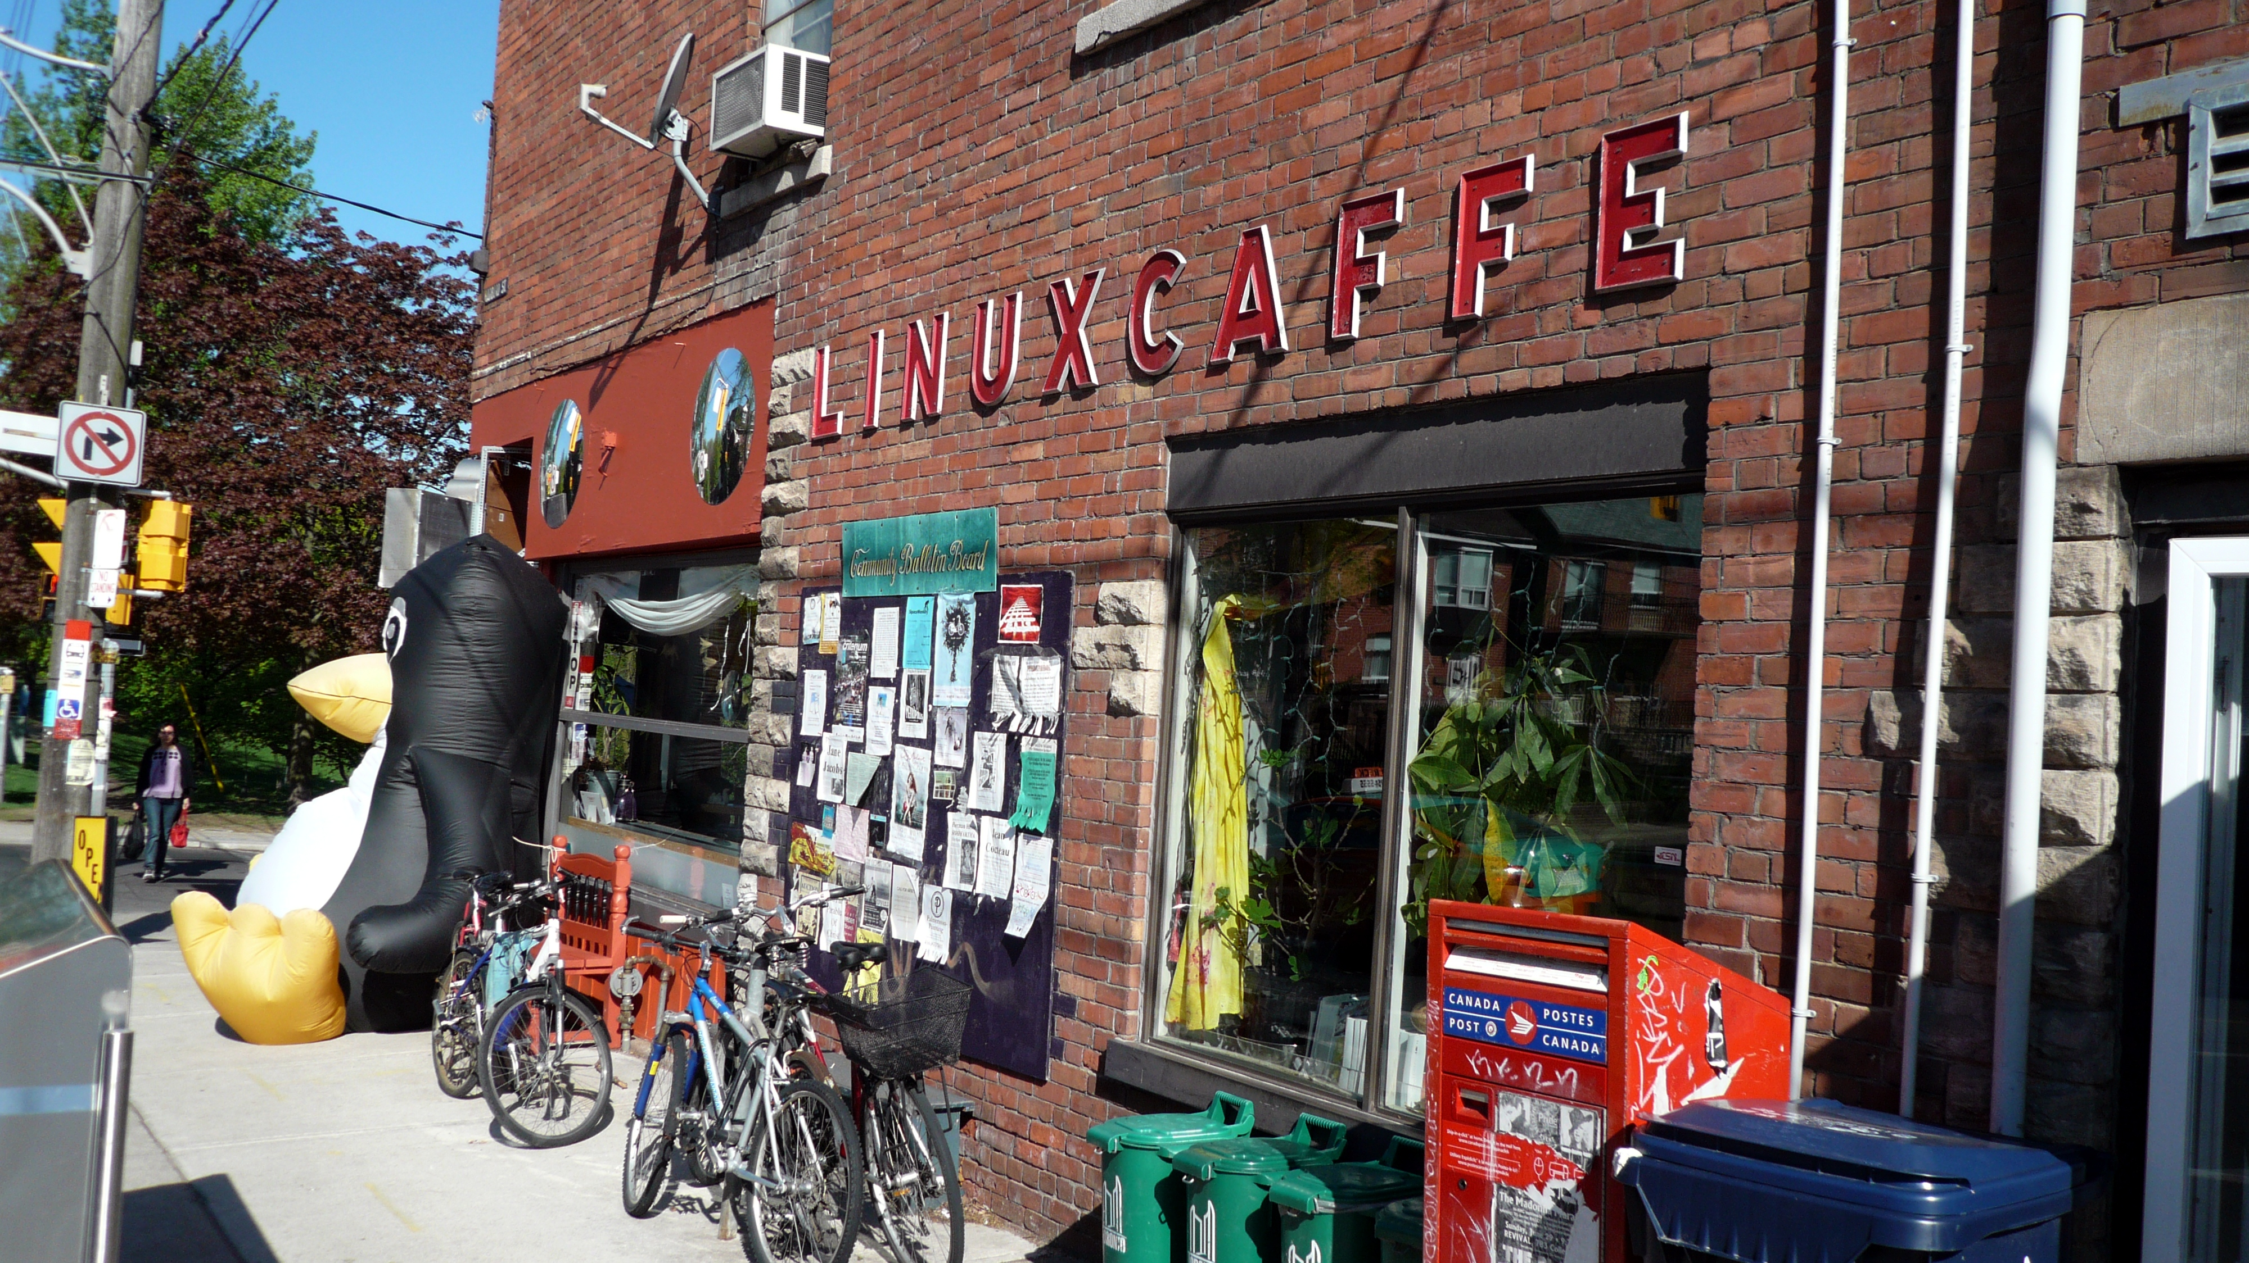
This Photo by Unknown Author is licensed under CC BY-SA

Slide 3
Choosing locations for cafes
Important to choose the prime locations!

Slide 4



Data
This Photo by Unknown Author is licensed under CC BY
This Photo by Unknown Author is licensed under CC BY-SA
This Photo by Unknown Author is licensed under CC BY-SA

Slide 5
Results

Slide 6
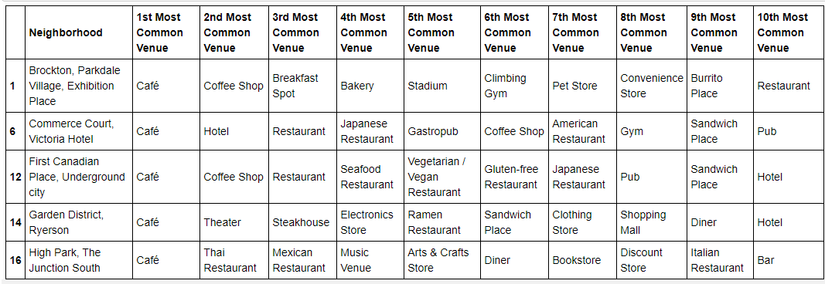
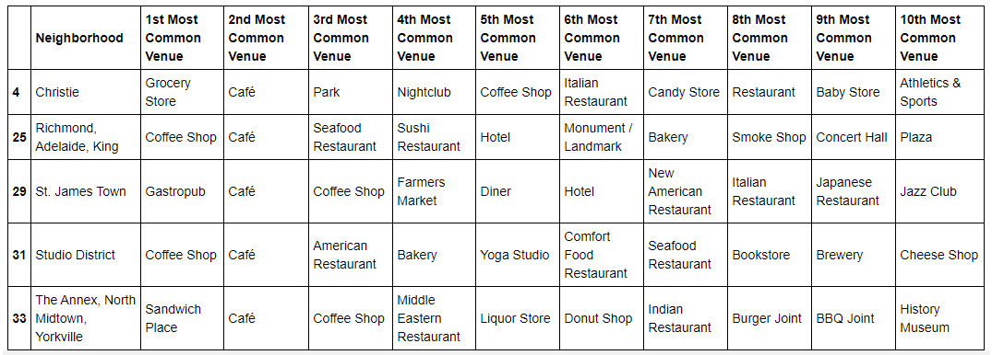

Slide 7
Best neighborhoods for cafes
Commerce Court, Victoria Hotel
First Canadian Place, Underground city
Garden District, Ryerson
High Park, The Junction South

Slide 8
Second Best Neighborhoods for cafes
Christie
Richmond, Adelaide, King
St. James Town
Studio District
The Annex, North Midtown, Yorkville

Slide 9

This Photo by Unknown Author is licensed under CC BY-SA

